Slide 1
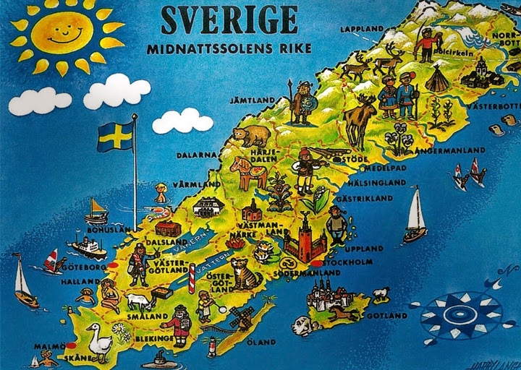
Sweden/Sverige

Slide 2
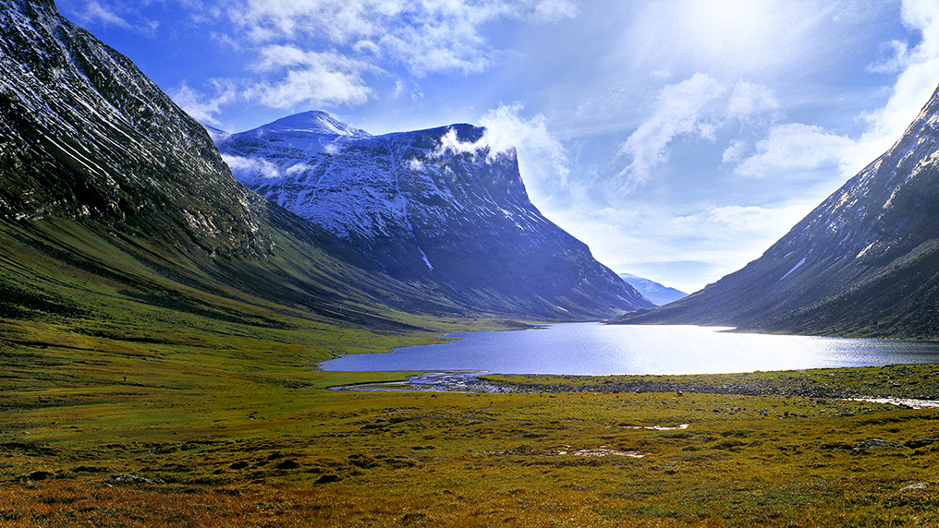
Swedish mountains and nature
In Sweden we have many mountains in on the north side of sweden and in the south of sweden it´s very flat land.

Slide 3
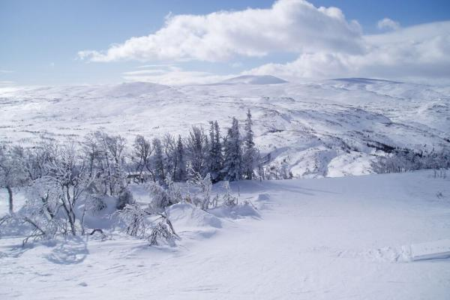
The highest mouantain in Sweden is Kebnekaise and it´s 2106 m over the sea level. In sweden we have four seasons we have summer, authun, winter and spring. A whole 4 months is Sweden covered with a surface of a shiny and beautiful snow that makes the country a nice place to visit if you don't mind of the cold.
The highest mouantain in Sweden is Kebnekaise and it´s 2106 m over the sea level. In sweden we have four seasons we have summer, authun, winter and spring. A whole 4 months is Sweden covered with a surface of a shiny and beautiful snow that makes the country a nice place to visit if you don't mind of the cold.

Slide 4
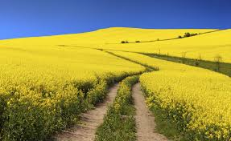
In the summer of sweden its warm like any other country except for the mountains and lakes that are exceptional. In the south sweden it´s a lot of fields with pretty flovers and plants

Slide 5
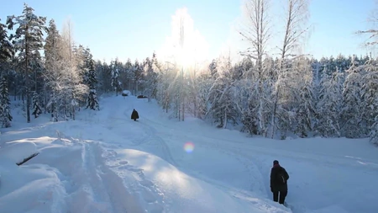
SNOW
Snow is frozen water that falls from the sky. Snow coming in the winter when it´s cold outside. It´s like a white cold powder. You can play whit snow and build snowman's.
Snow it´s not in everyone's countries, but in Sweden there is snow.
In Sweden we called it "snö"

Slide 6
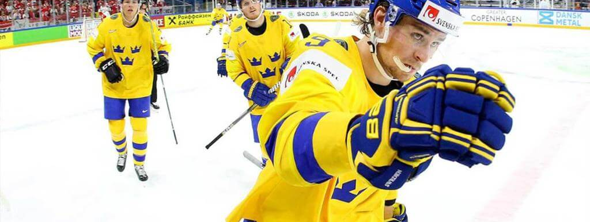
Hockey
Sweden has had many good hockey players over the years, for example Peter Forsberg, Viktor Hedman, Linus Ullmark

Slide 7
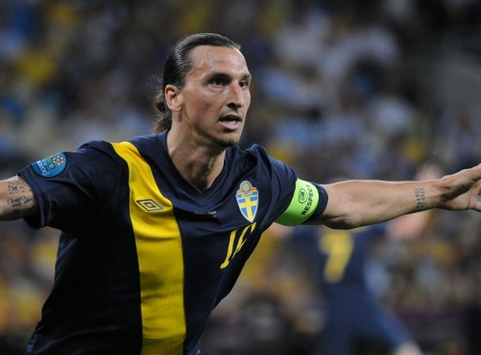
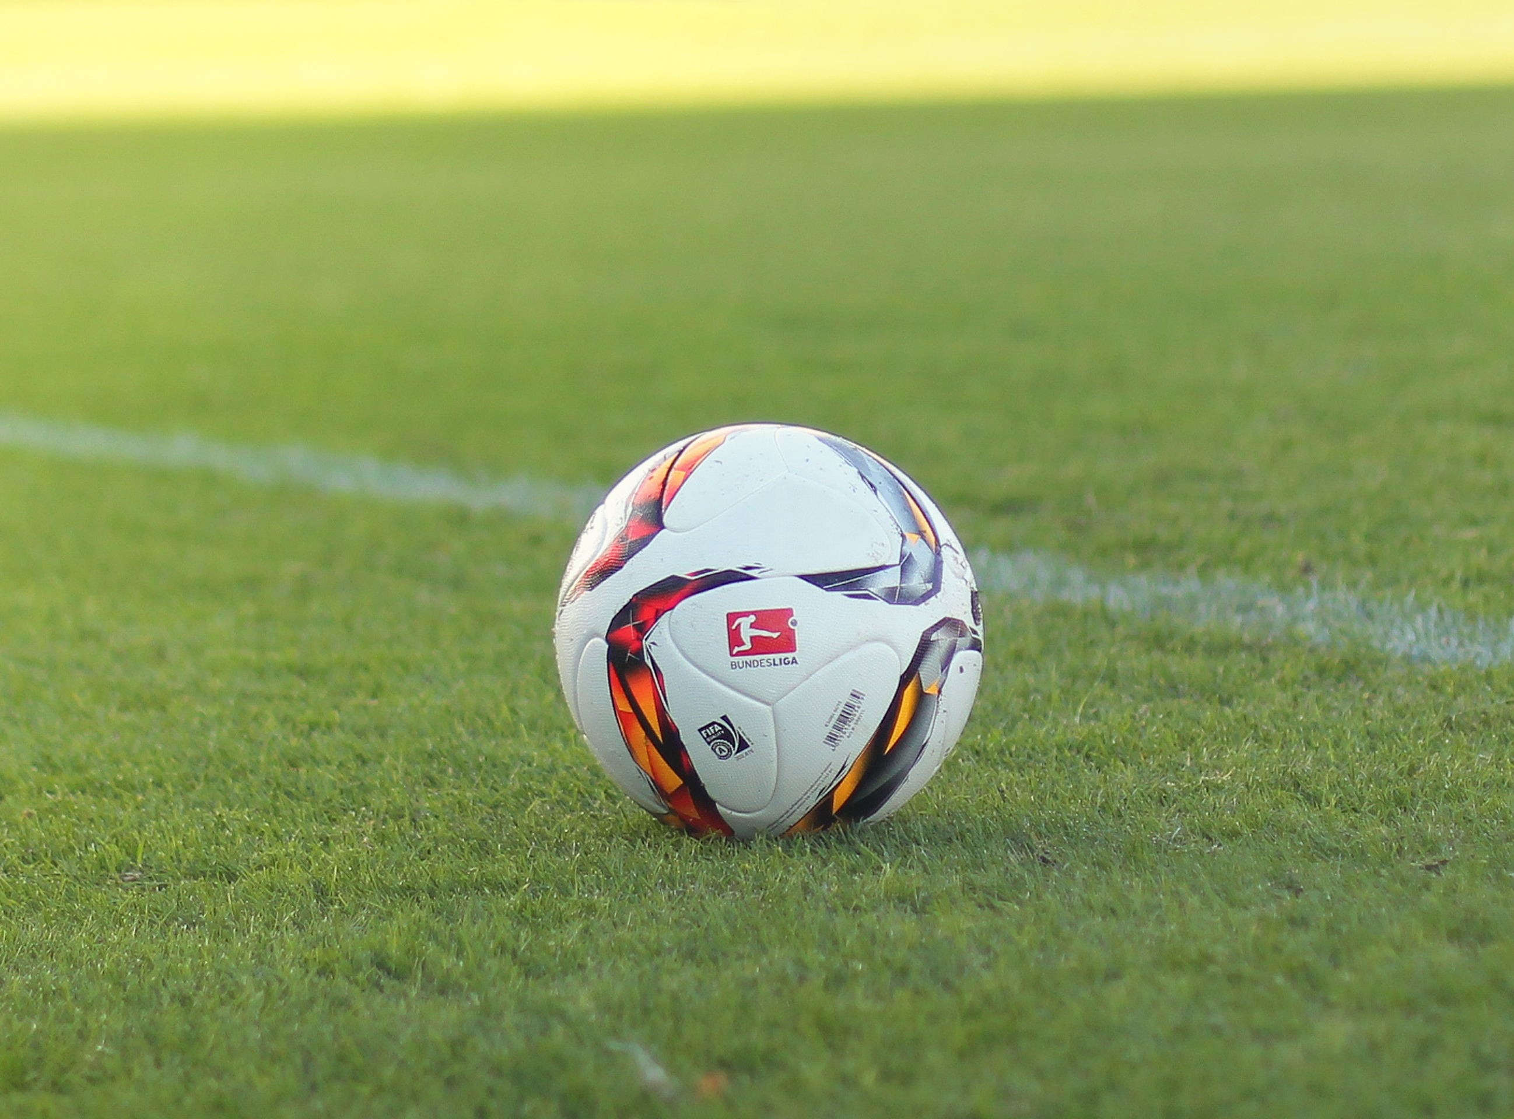
Det här fotot av Okänd författare är licensierat enligt CC BY-SA.
The faumos swedish soccer player is Zlatan Ibrahimovic. Soccer is very popular sport in swedish.

Slide 8
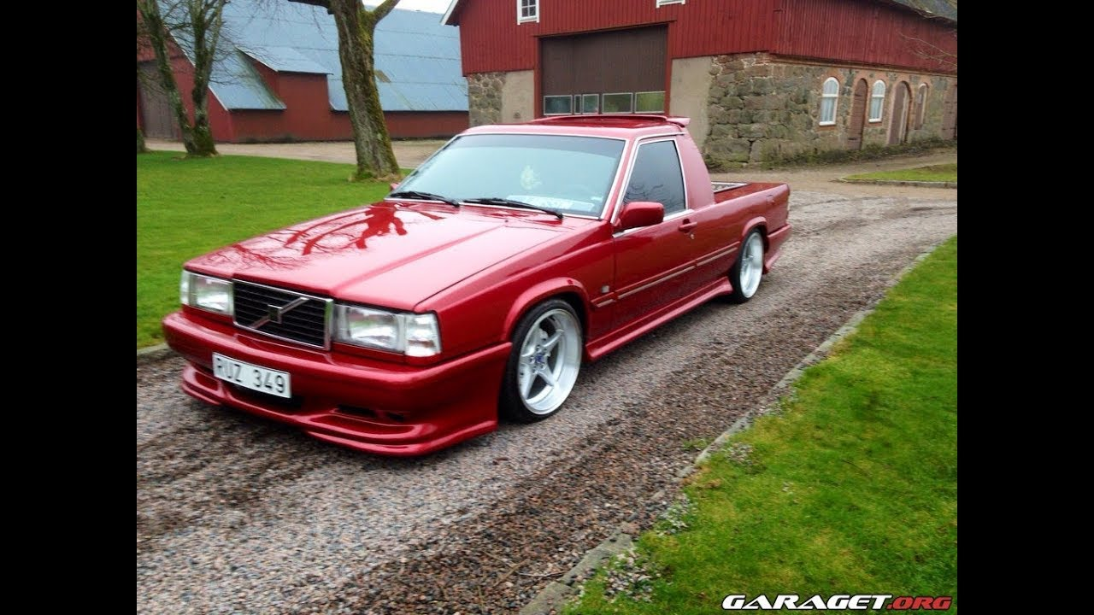
EPA tractor
Its a slow cuted car and its only going 30kph.
And you can take Epa licens when you are 15 years old and its illegal to drive on the highway

Slide 9

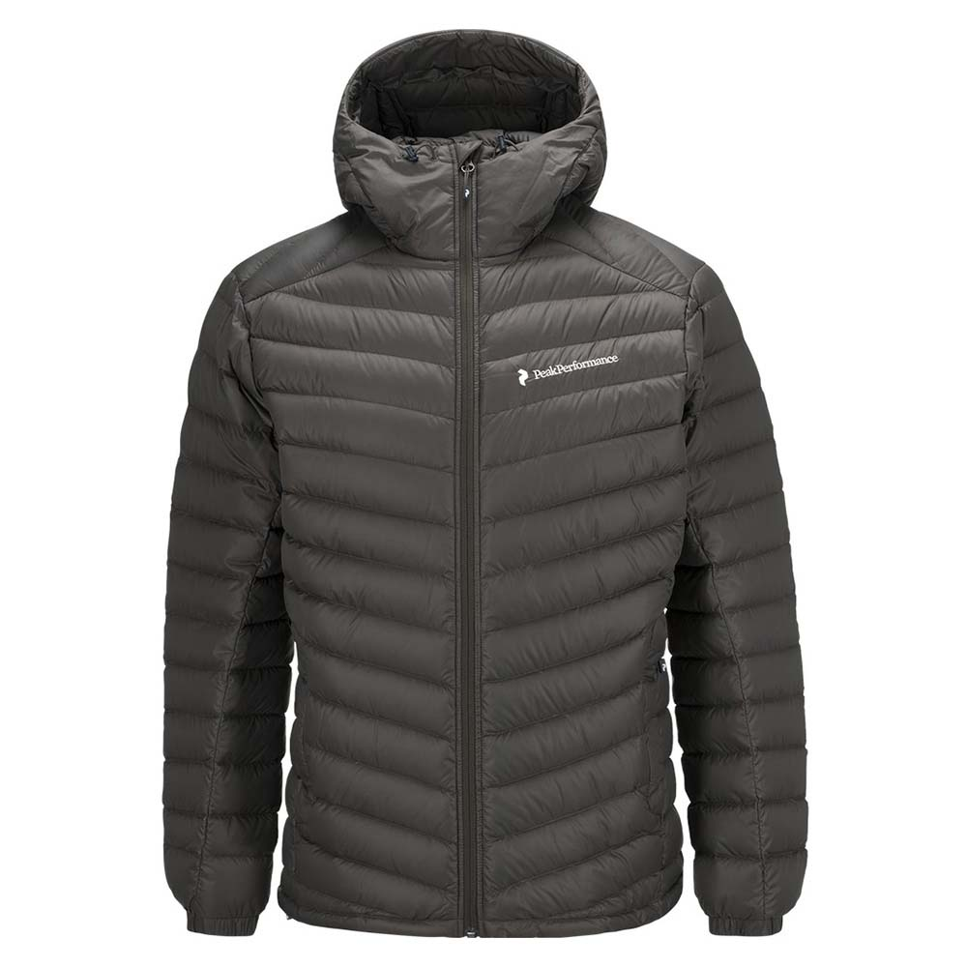
Fashion
In Sweden we like fashion. The most famous fashion company in Sweden is H&M.
The jaket you see is called "Peak Performance" and many teenagers have them. And they are expensive.

Slide 10

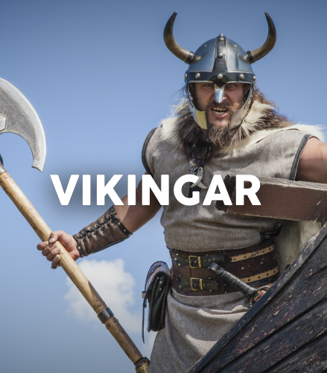



The wikings in Sweden lived there from 700 a.kr to 1100 a.kr

Slide 11
Wikings
The wikings in Sweden were true barbarians. They ruled north Europé and would go out raids and steal from villages allthrough Europé.
They lived in big longhouses near the water to be able to have many ships.
It's people that believe that the people that discovered America and not Columbus.

Slide 12
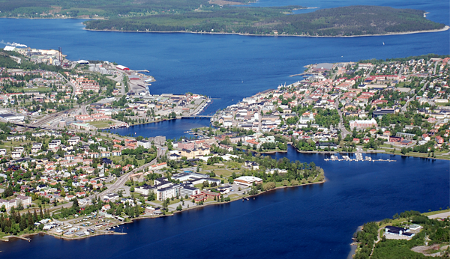
Härnösand

Slide 13
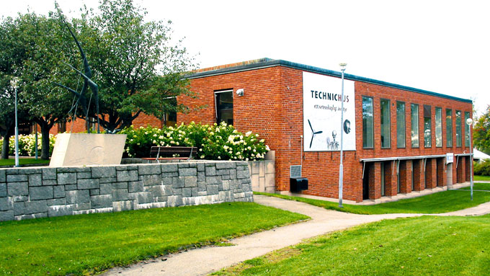
This is called technichus.
In technichus play and the children paint. Technichus is a science center with the goal of attracting interest in science and technology for children, adolescents and adults in a fun way.

Slide 14
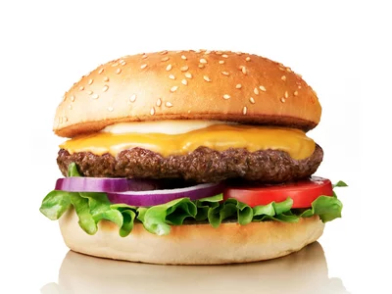
BURGERS
In Härnösand we have 6 burgerrestaurants and soon we have 7. That's really much in this small town. We change from ordinary restaurants to burgersresturants.

Slide 15
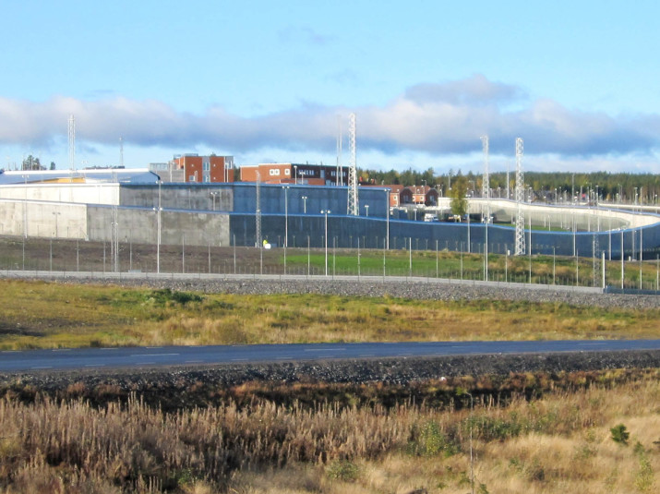
SALTVIK
Saltvik it´s a prison in Härnösand. It´s the third safety and biggest prison in Sweden. The most dangerous prisoners in Sweden are inmates in Saltvik. There is 250 persons that works in Saltvik.

Slide 16
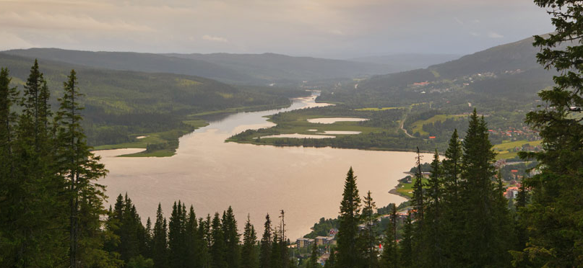
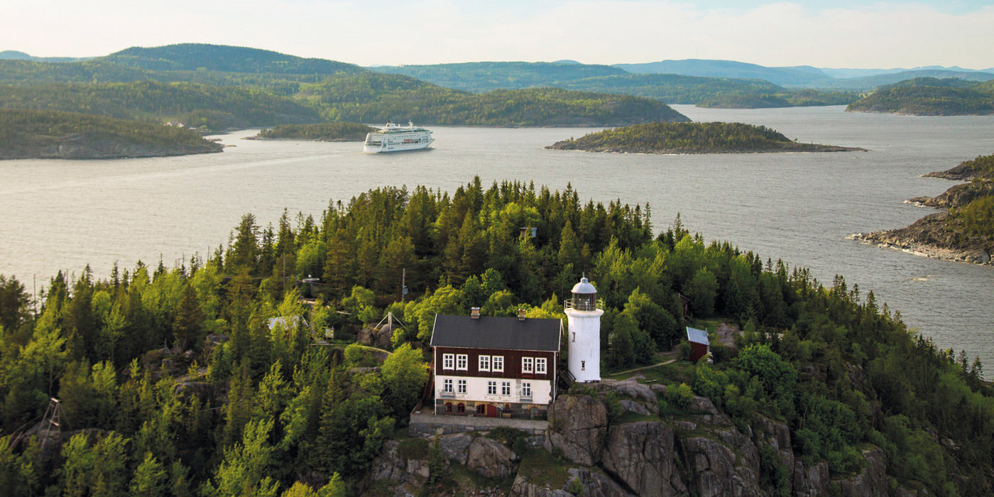
Höga Kusten
Höga Kusten is a beautiful place to go in the summer. Every summer it atracts a lot of tourists cause of its high mountains, fine valleys and inredible views. Höga Kusten is considered the most pretty looking place in Sweden and it evens has a Hotel there.
Raza

Slide 17
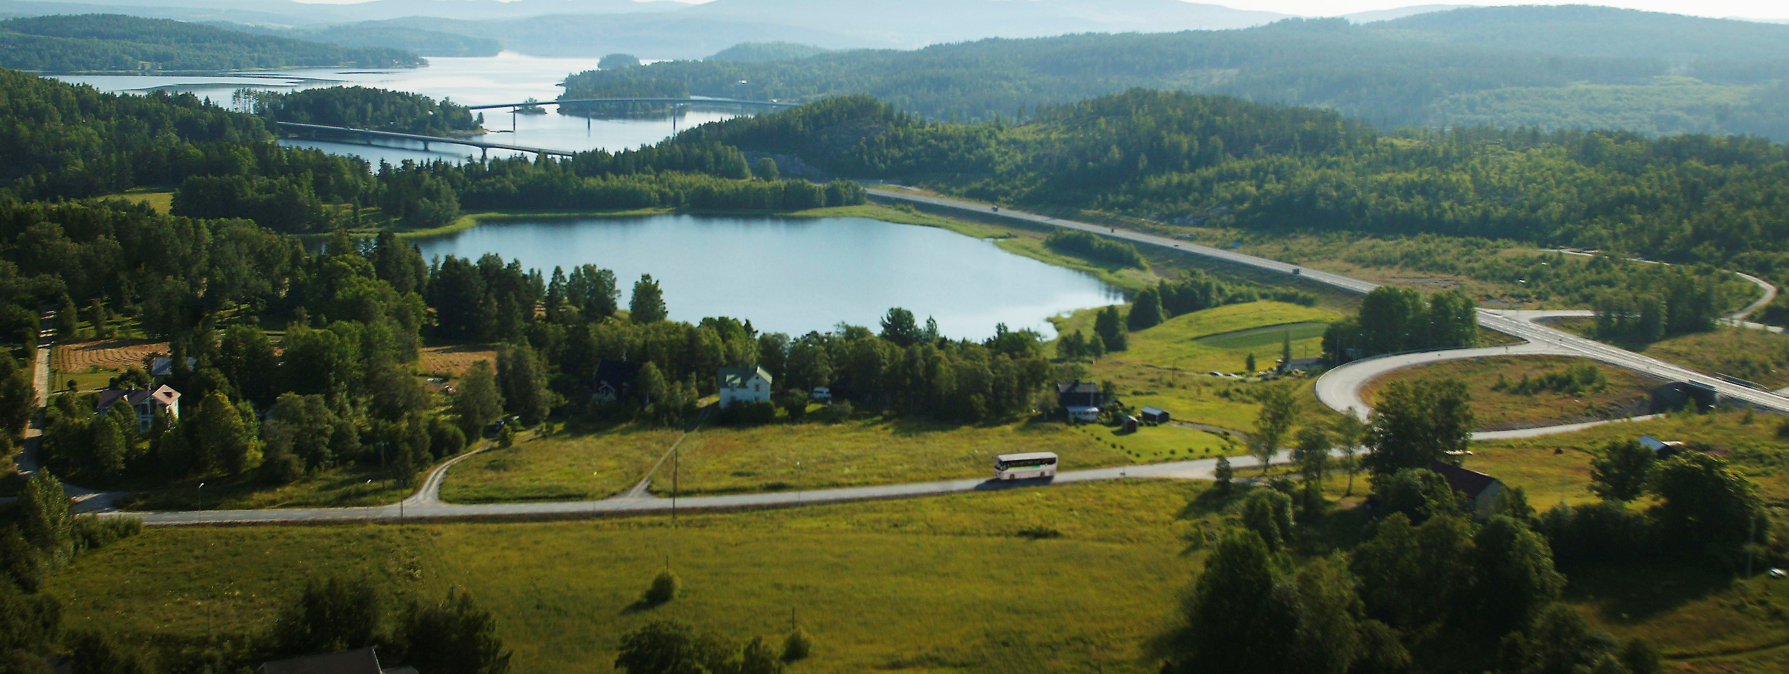
Hotell Höga Kusten
Höga Kusten Hotell is a famous and a very good hotel that is rated with 4,3 stars. It's located in Härnösand and it has very good views to the lake and its beautiful at summer. A lot of tourist are attracted to come there in the summer.
Raza

Slide 18

Härnö gin
Härnö gin is one of the world's leading gin companies. The company has taken home prices after prices and they are very successful.

Slide 19
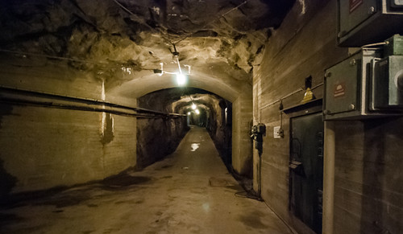
Hemsöfästning
Fort Hemsö
That’s an old army camp in the mouinten.
And if we most go into a fight so can we use it.

Slide 20
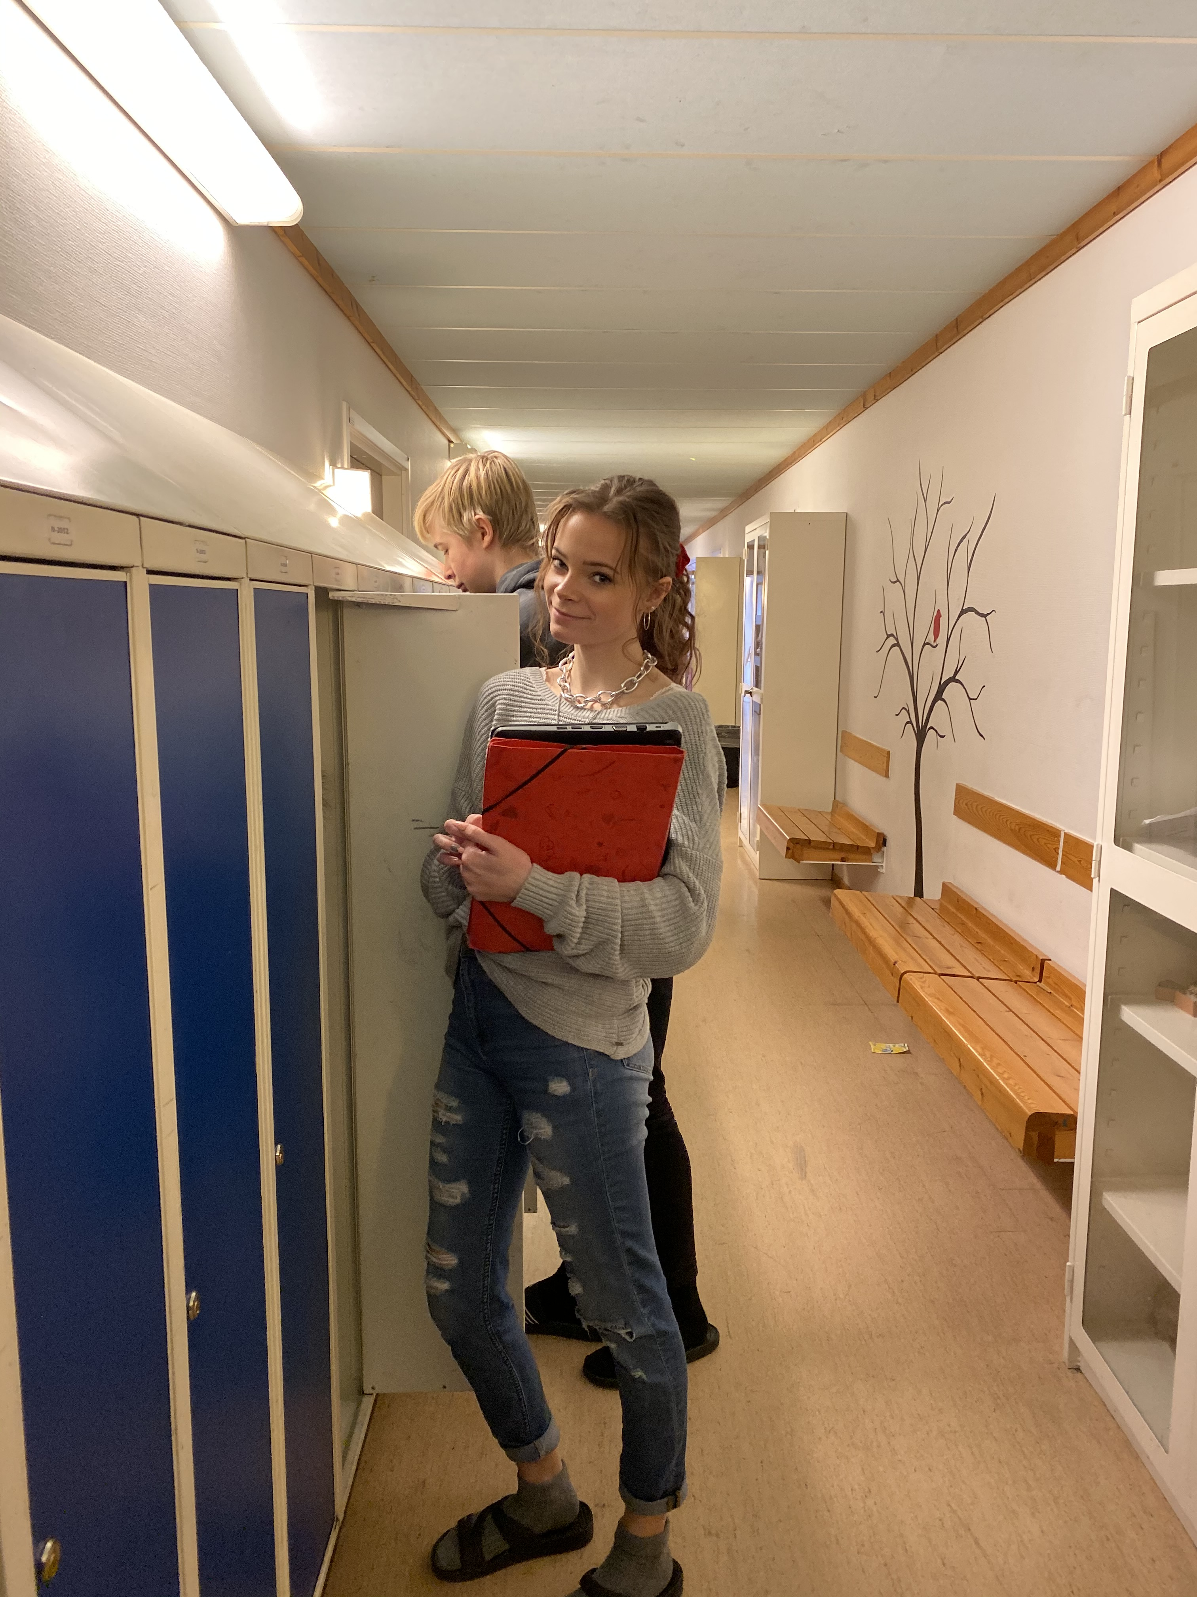
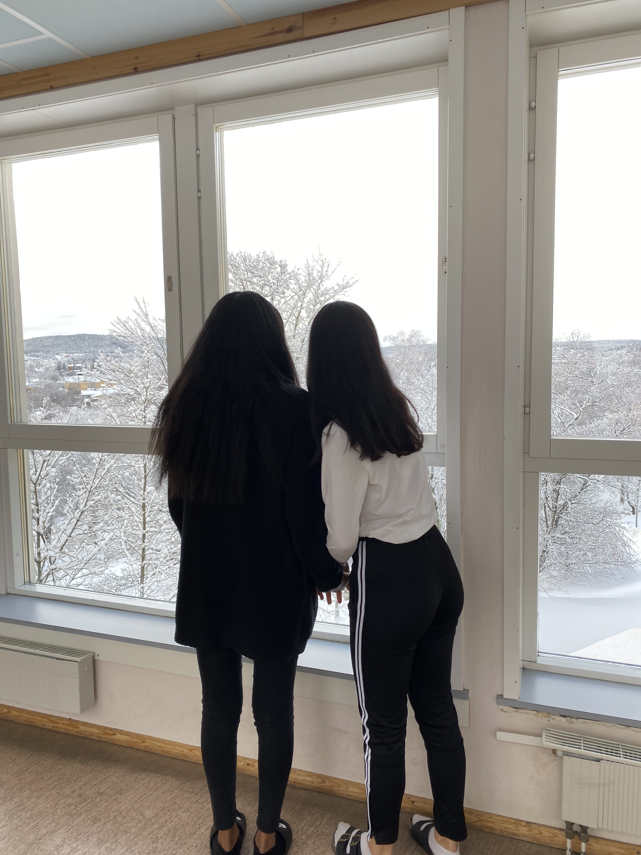
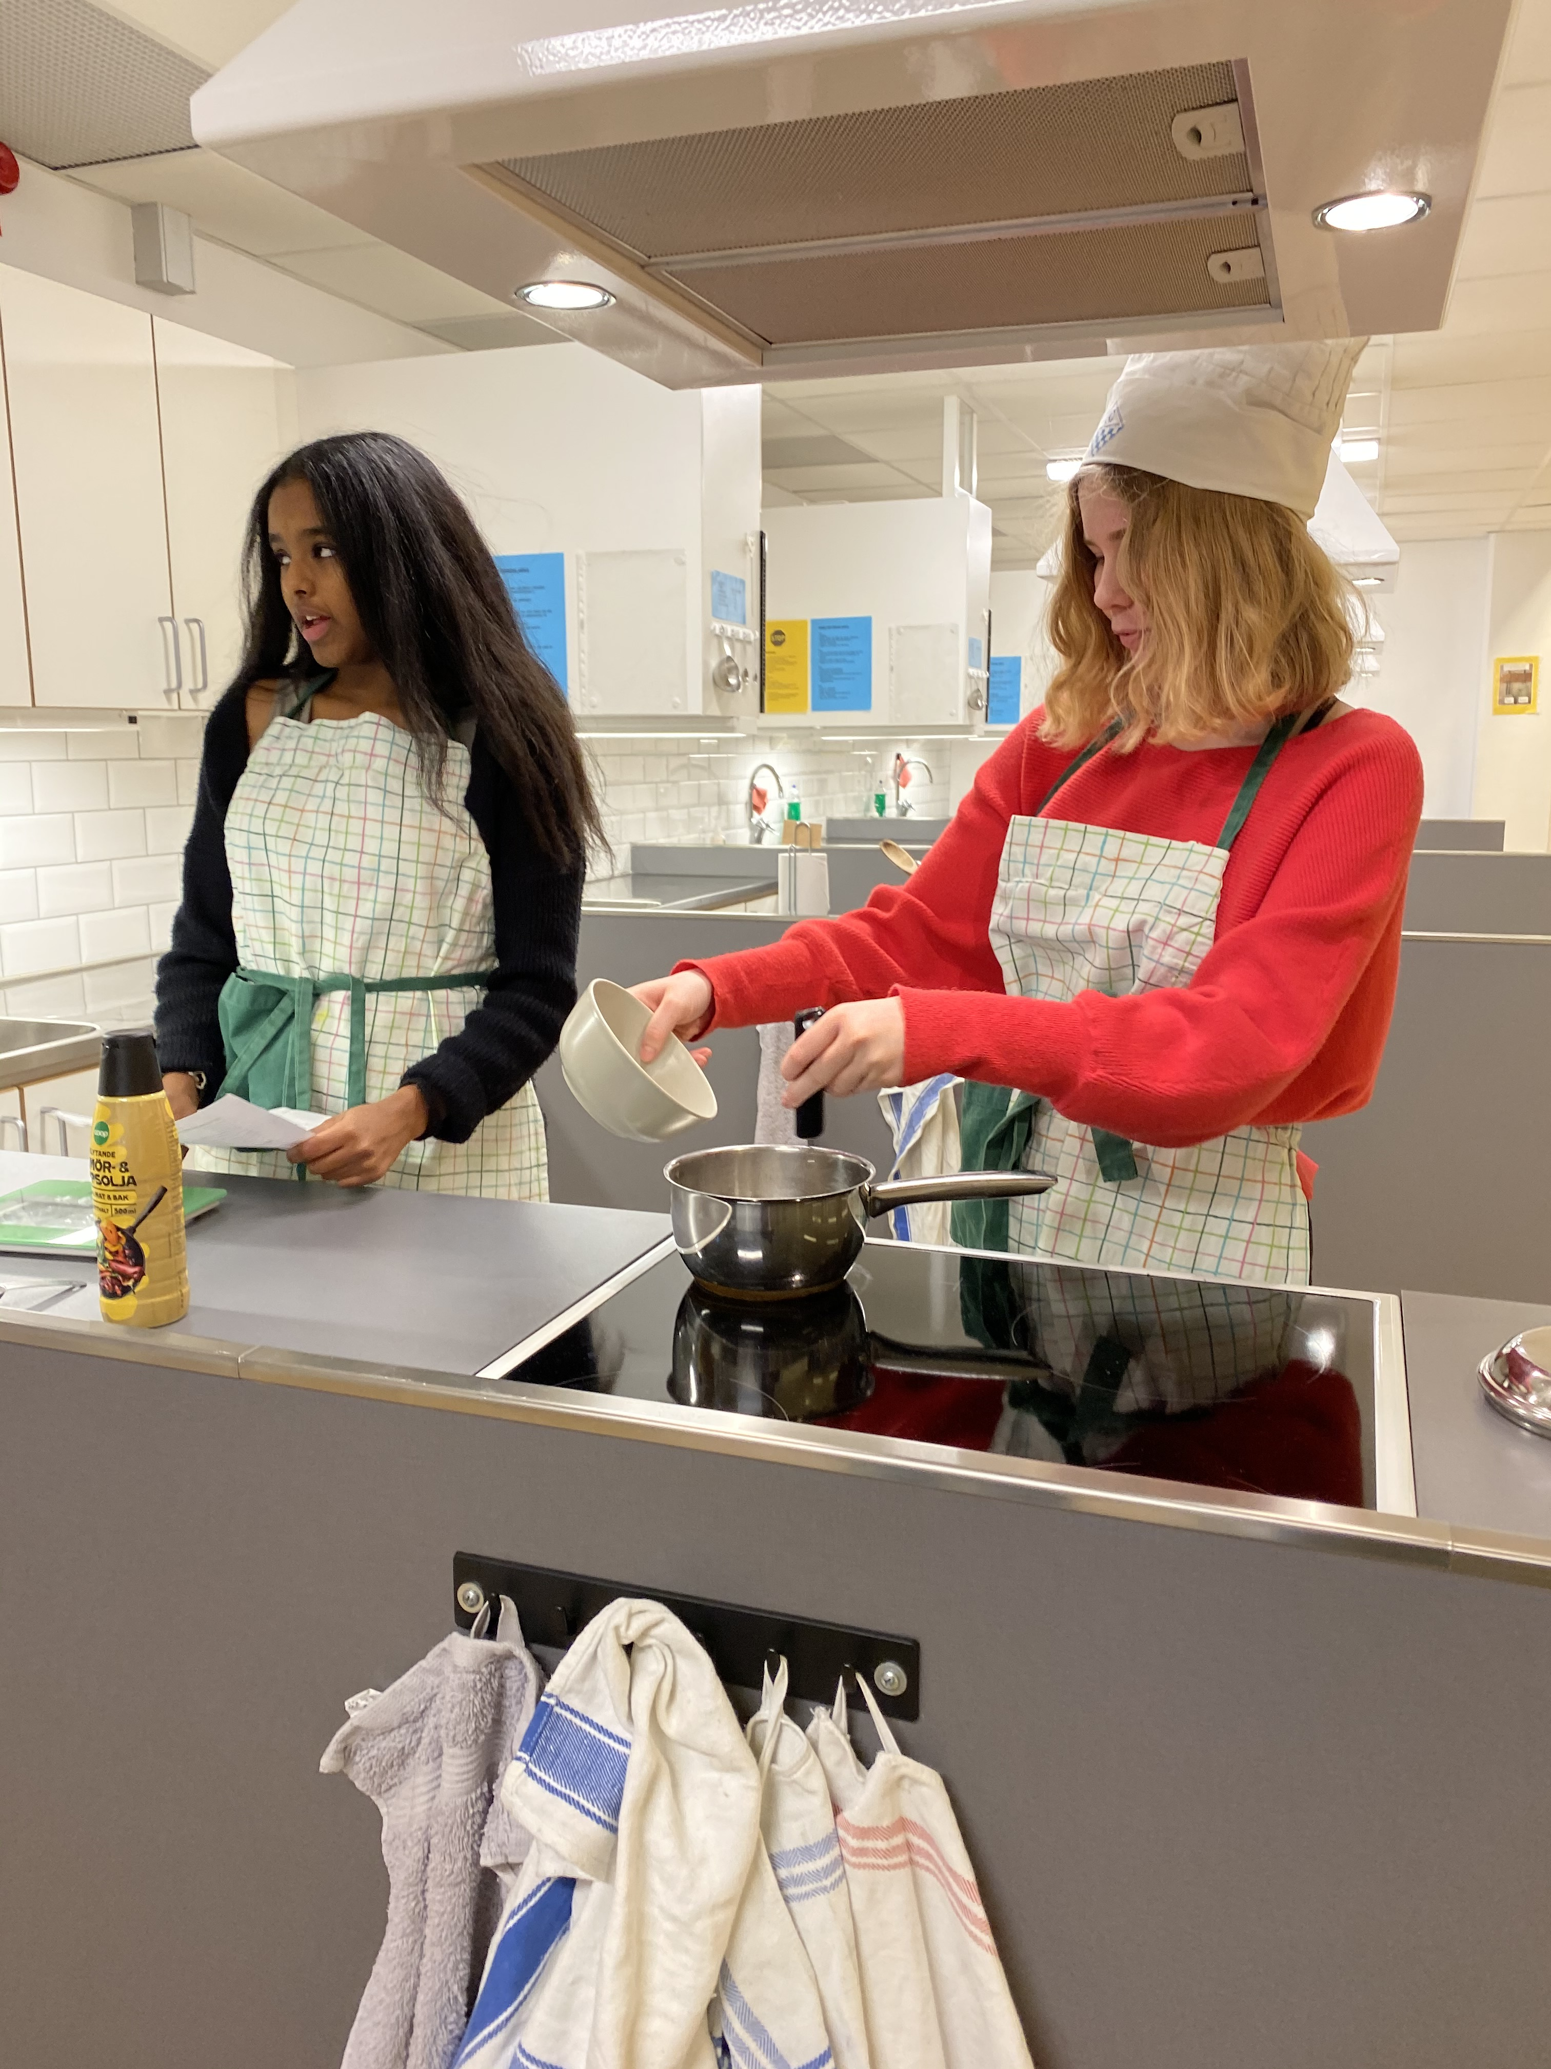


The School of Hedda Wising
A place of challenges, curiosity and learning.

Slide 21
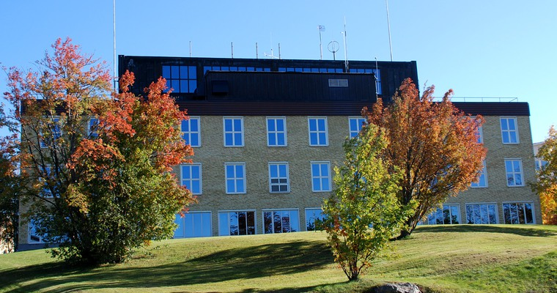
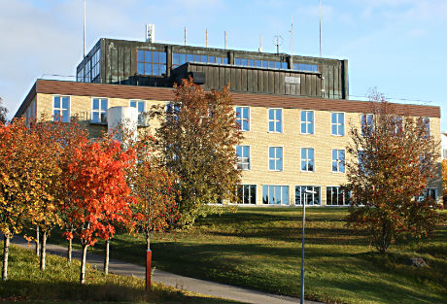
The School at the Hill Top
The school of Hedda Wising resides at the top of a beautiful hill, close to both nature and the centre of Härnösand. In the spring as well as in the summer, the surrounding nature is very green; but as autumn comes closer, the leaves and the ground turn yellow – and eventually red. In winter, the entire ground is usually covered with a thick blanket of snow.

Slide 22
Our Values and Guidelines
Courage, thirst for knowledge, social skills and cooperation. Our school works hard to incorporate these values into every day at Hedda Wising.
A group of ninth graders finding time between lessons to play a classic game of foosball.
A couple of eighth graders working on a project for english class.
Two students looking up at the school of Hedda Wising.

Slide 23
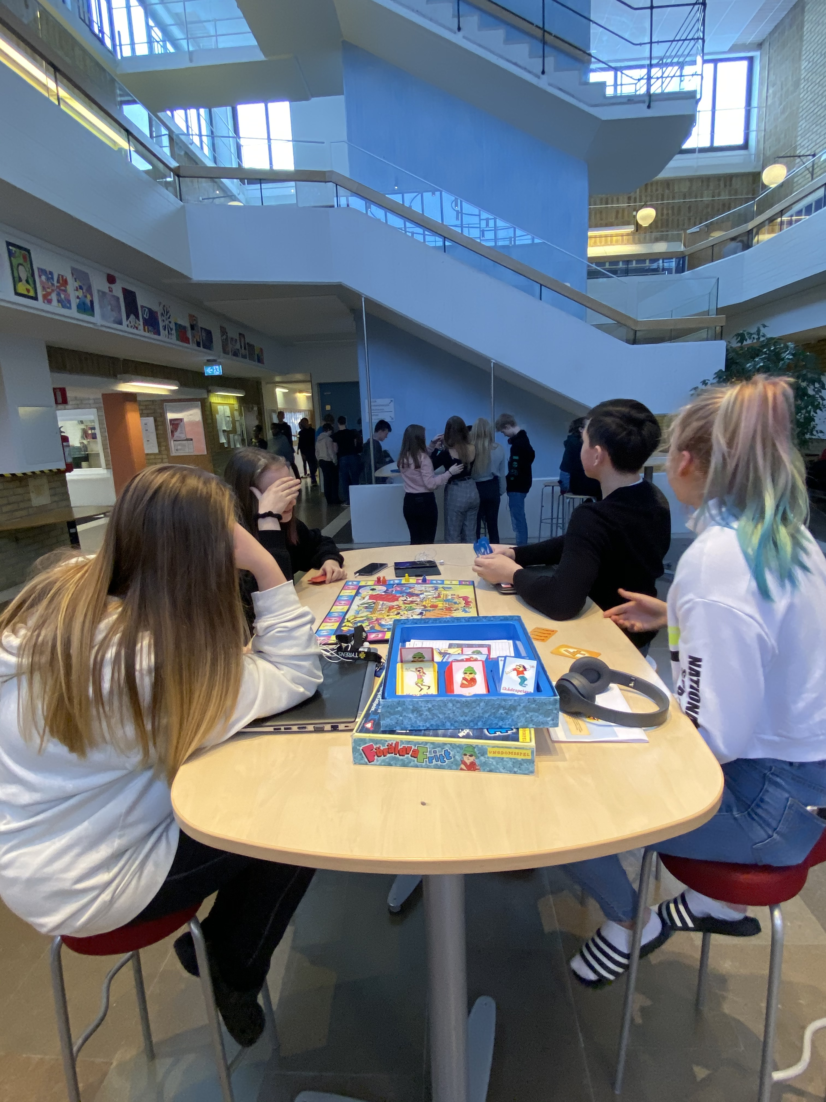
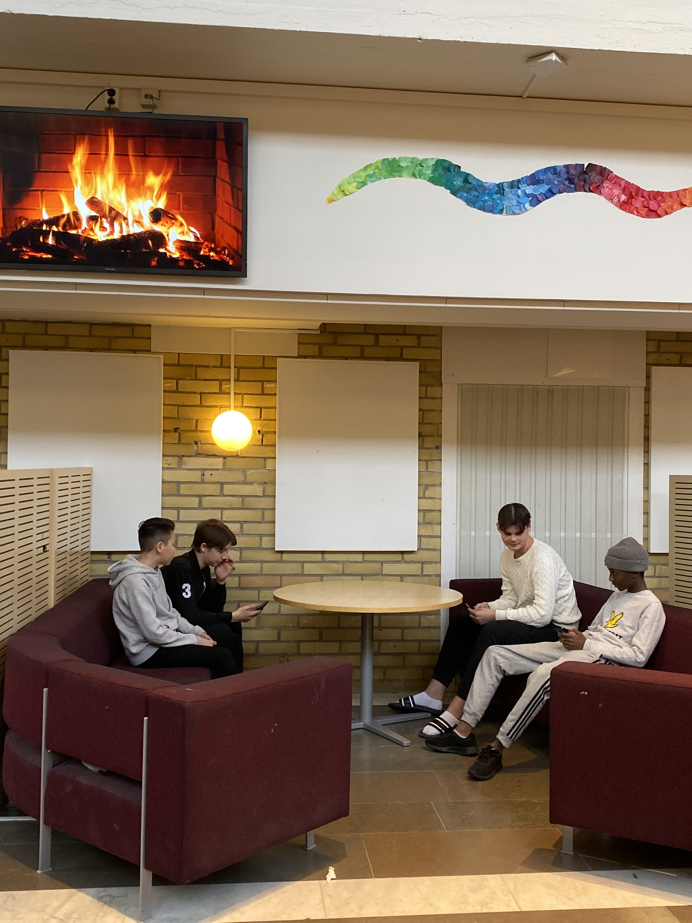
Hall of Lights
The school has a place for all the students and the teachers to hang out in. It's called the "Hall of Lights". Do you think there's a reason behind that name?

Slide 24
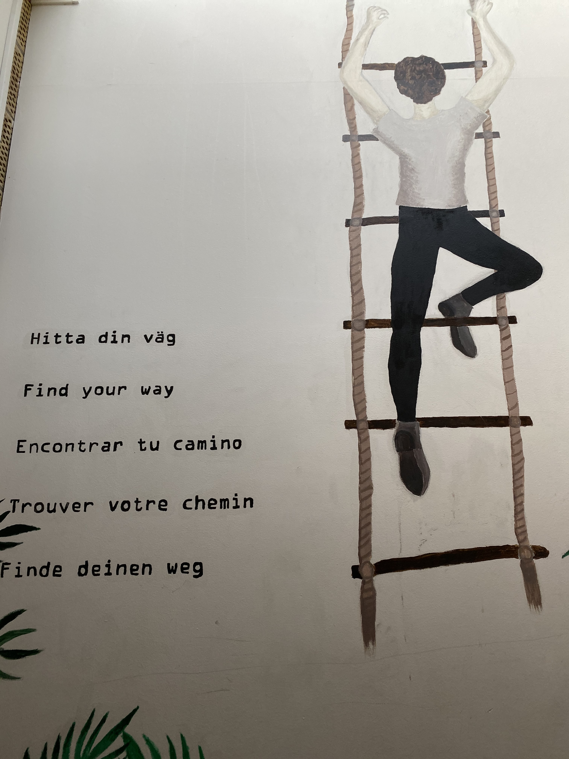
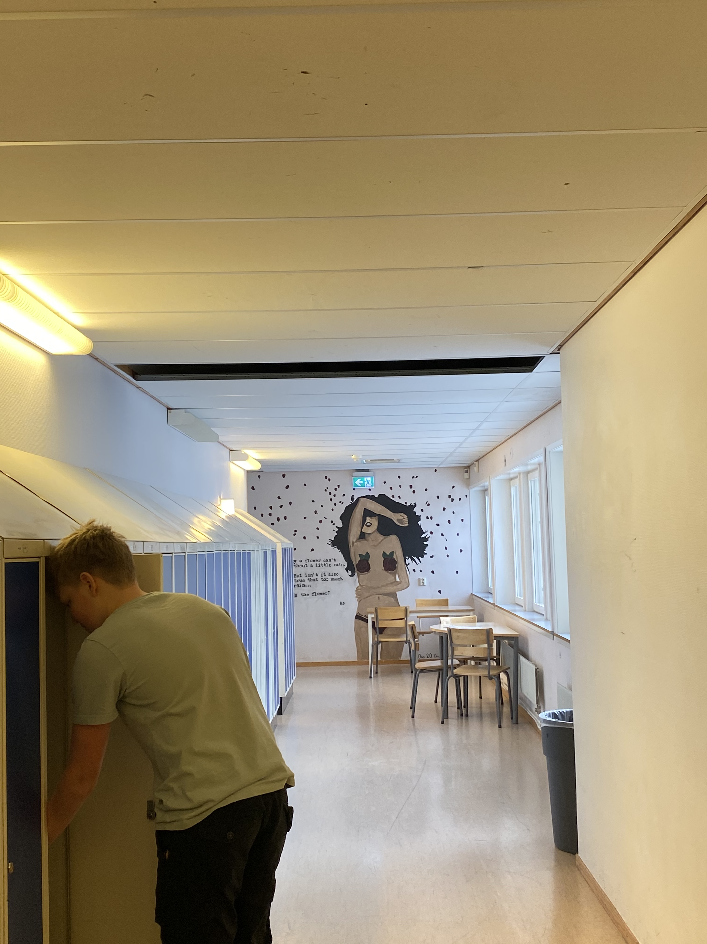
A Study in the Arts
Many students at Hedda Wising are talented artists. Our walls are covered with beautiful paintings that students themselves have created.

Slide 25
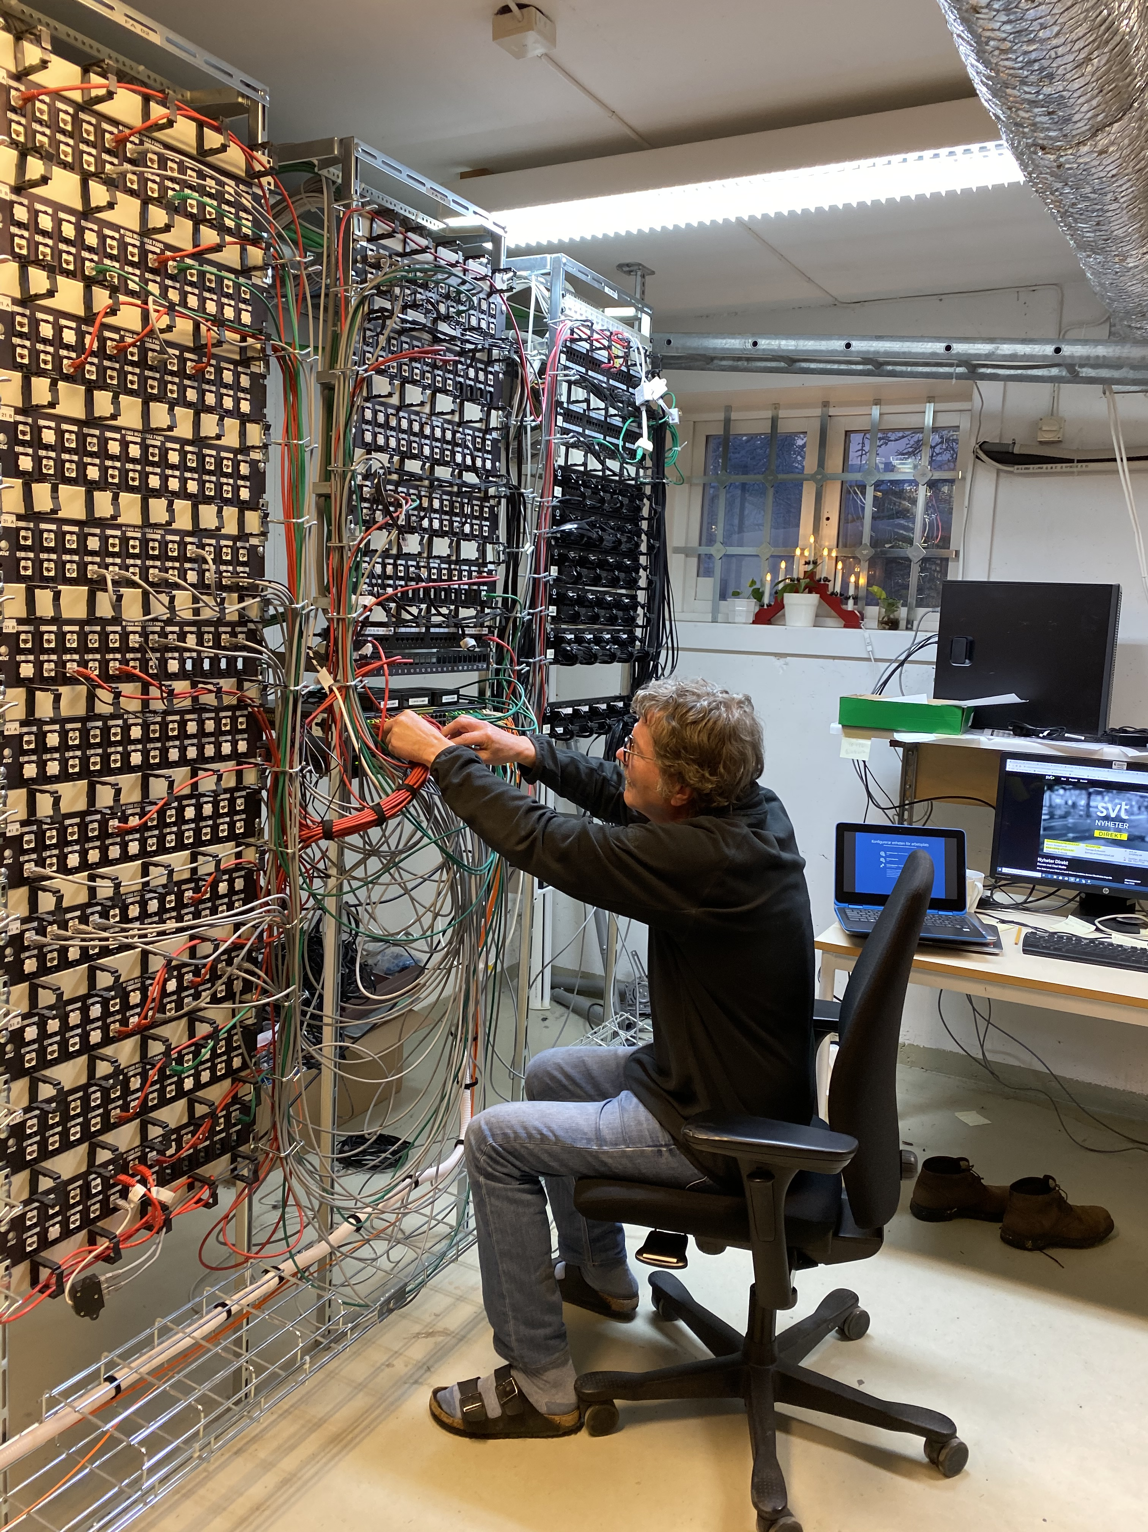
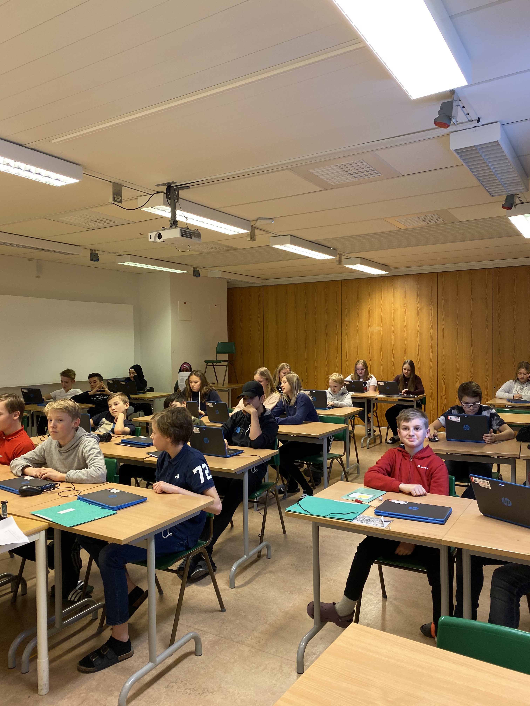
Online Classrooms
In a world that is becoming more globalised and technological by the minute, Hedda Wising has adapted quickly. Our schoolwork and all our schoolbooks have now been digitalised!
Börje works in the tech departement at our school. He has an extreme workload on his shoulders every day, but still takes the time to say hi and talk to all the students that stop by his office.
If you look closely, you can see that all the students in this picture have computers in front of them.

Slide 26
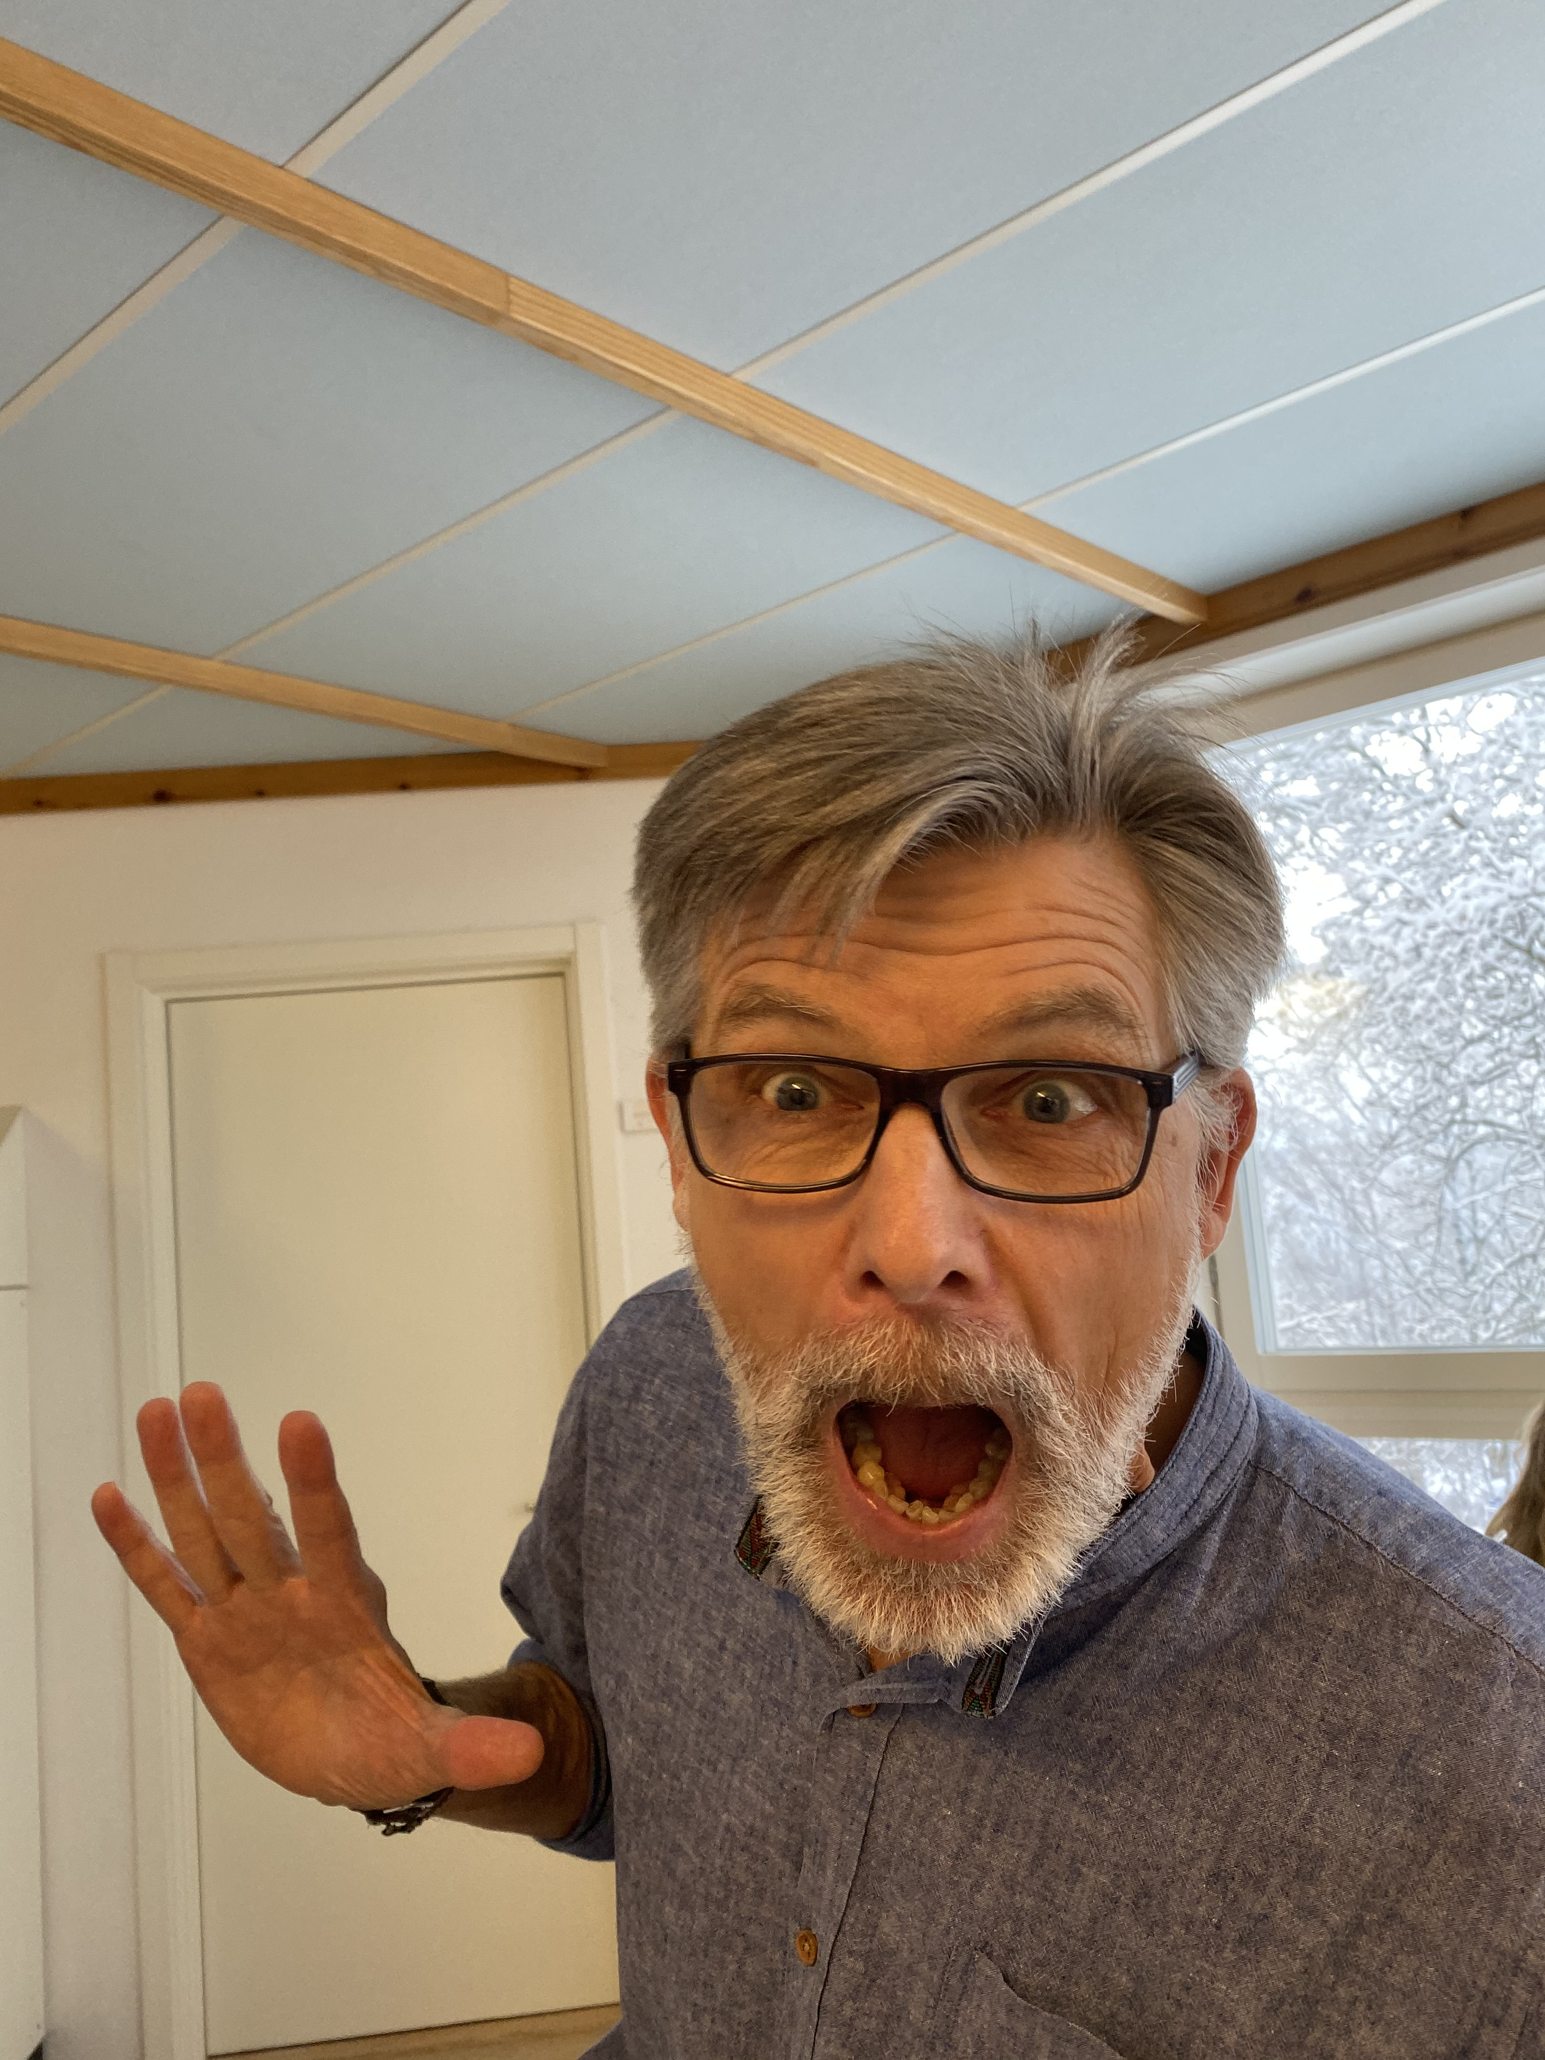
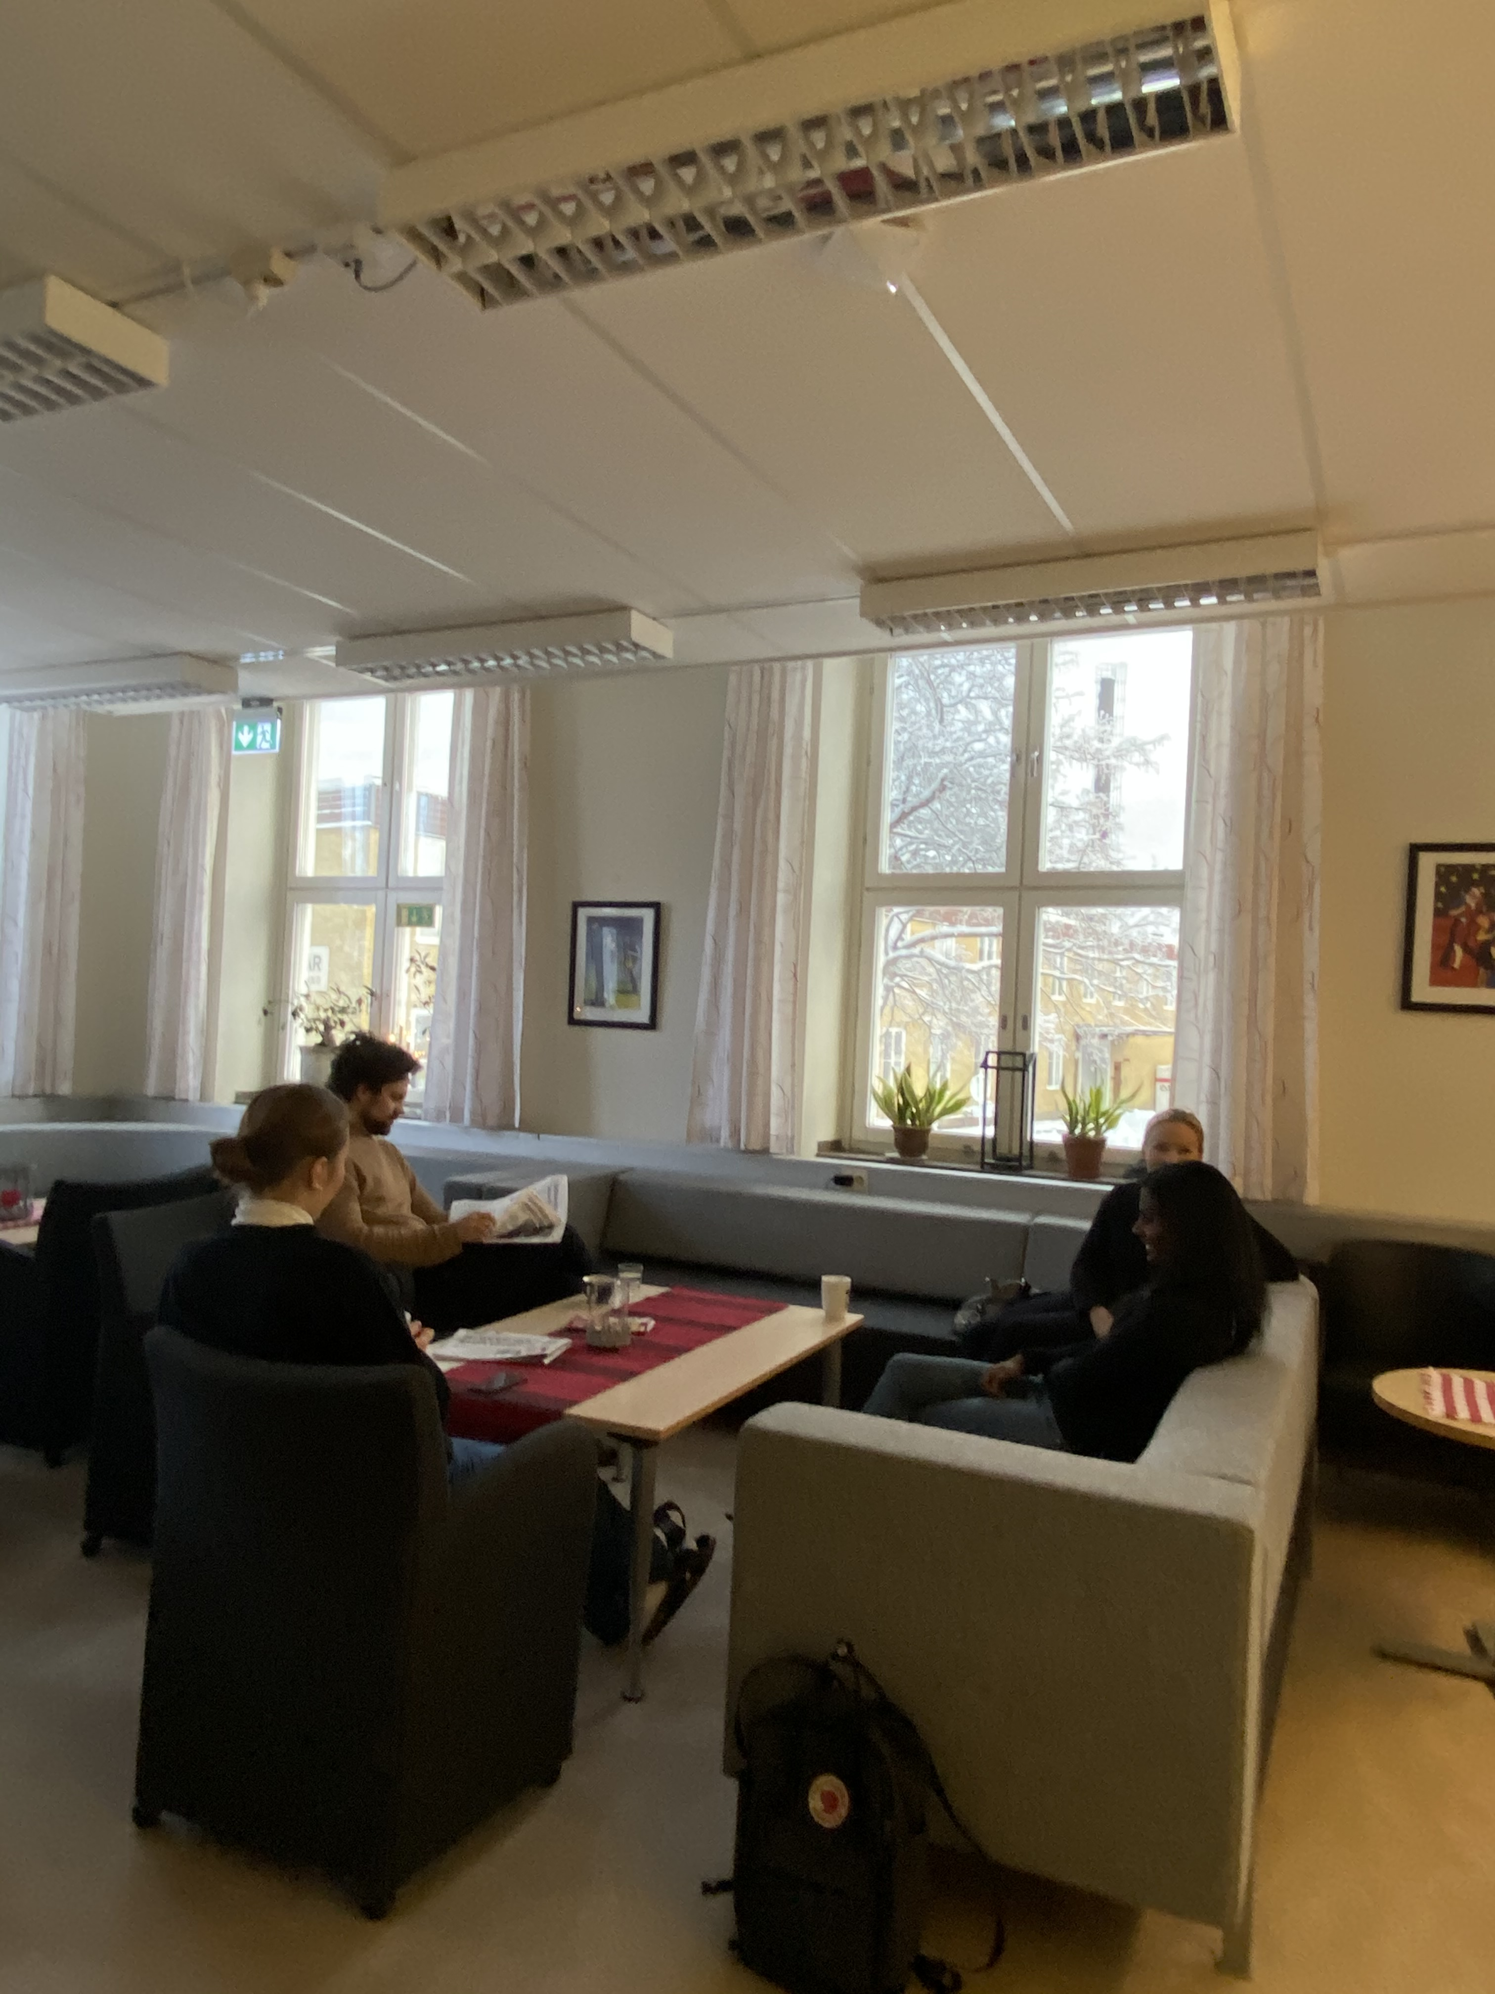
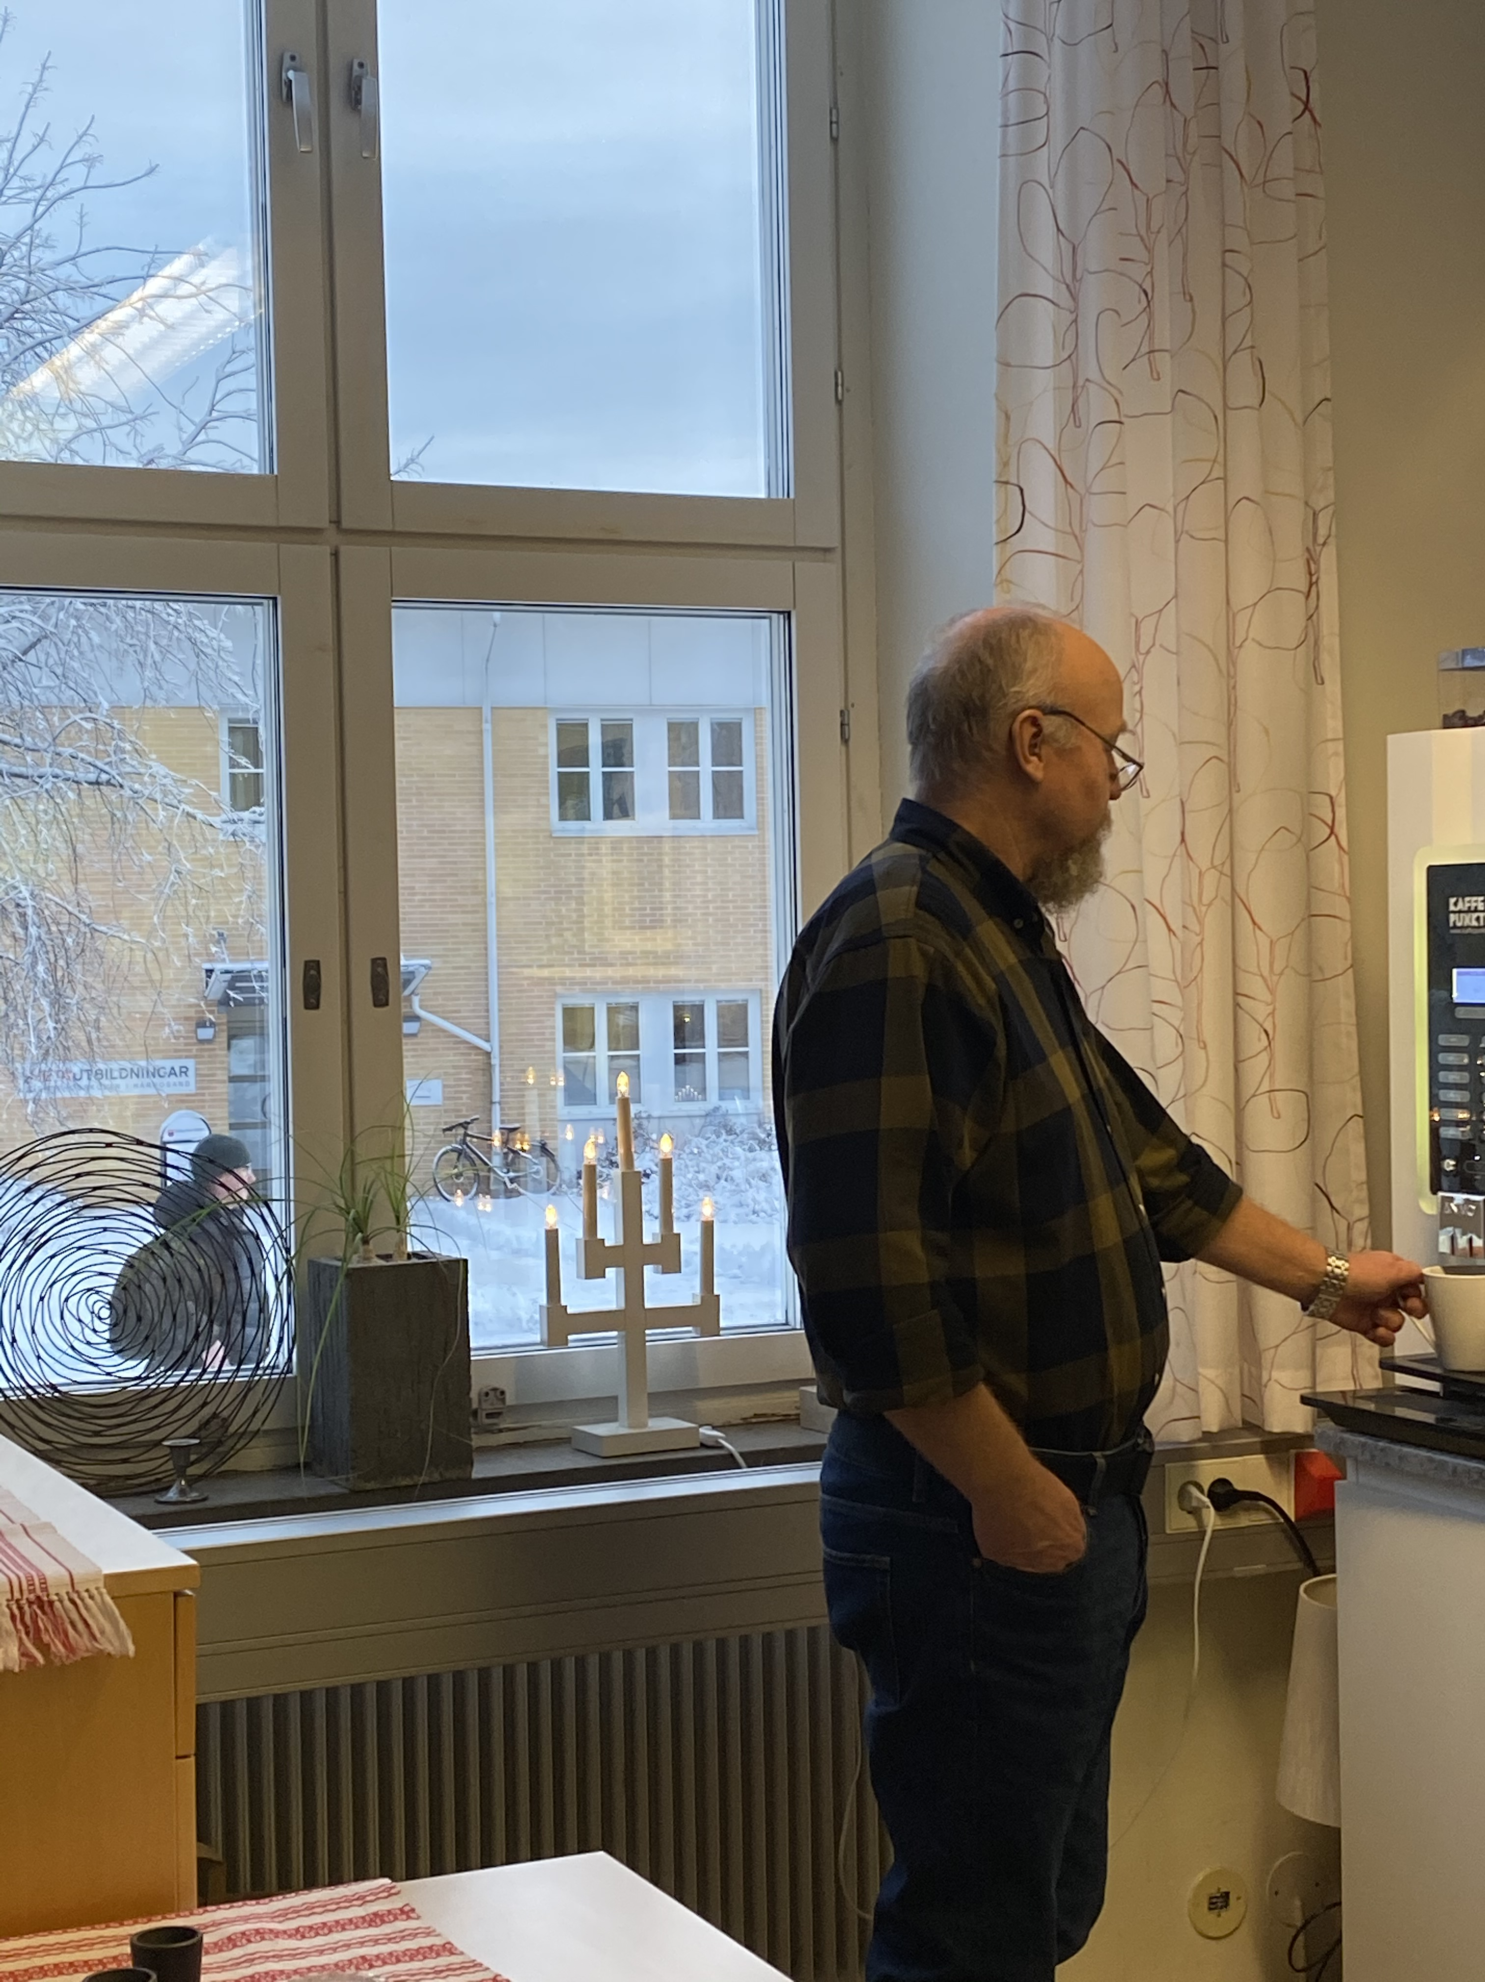
The Adults of Hedda Wising
Our vice-principal Johan Vallgårda posing for a picture.
Some teachers seated in the teachers’ lounge, one of them pretend-reading a newspaper to look clever.
Per-Olov (PO), one of our science and maths teachers, grabbing a coffee inbetween lessons.

Slide 27
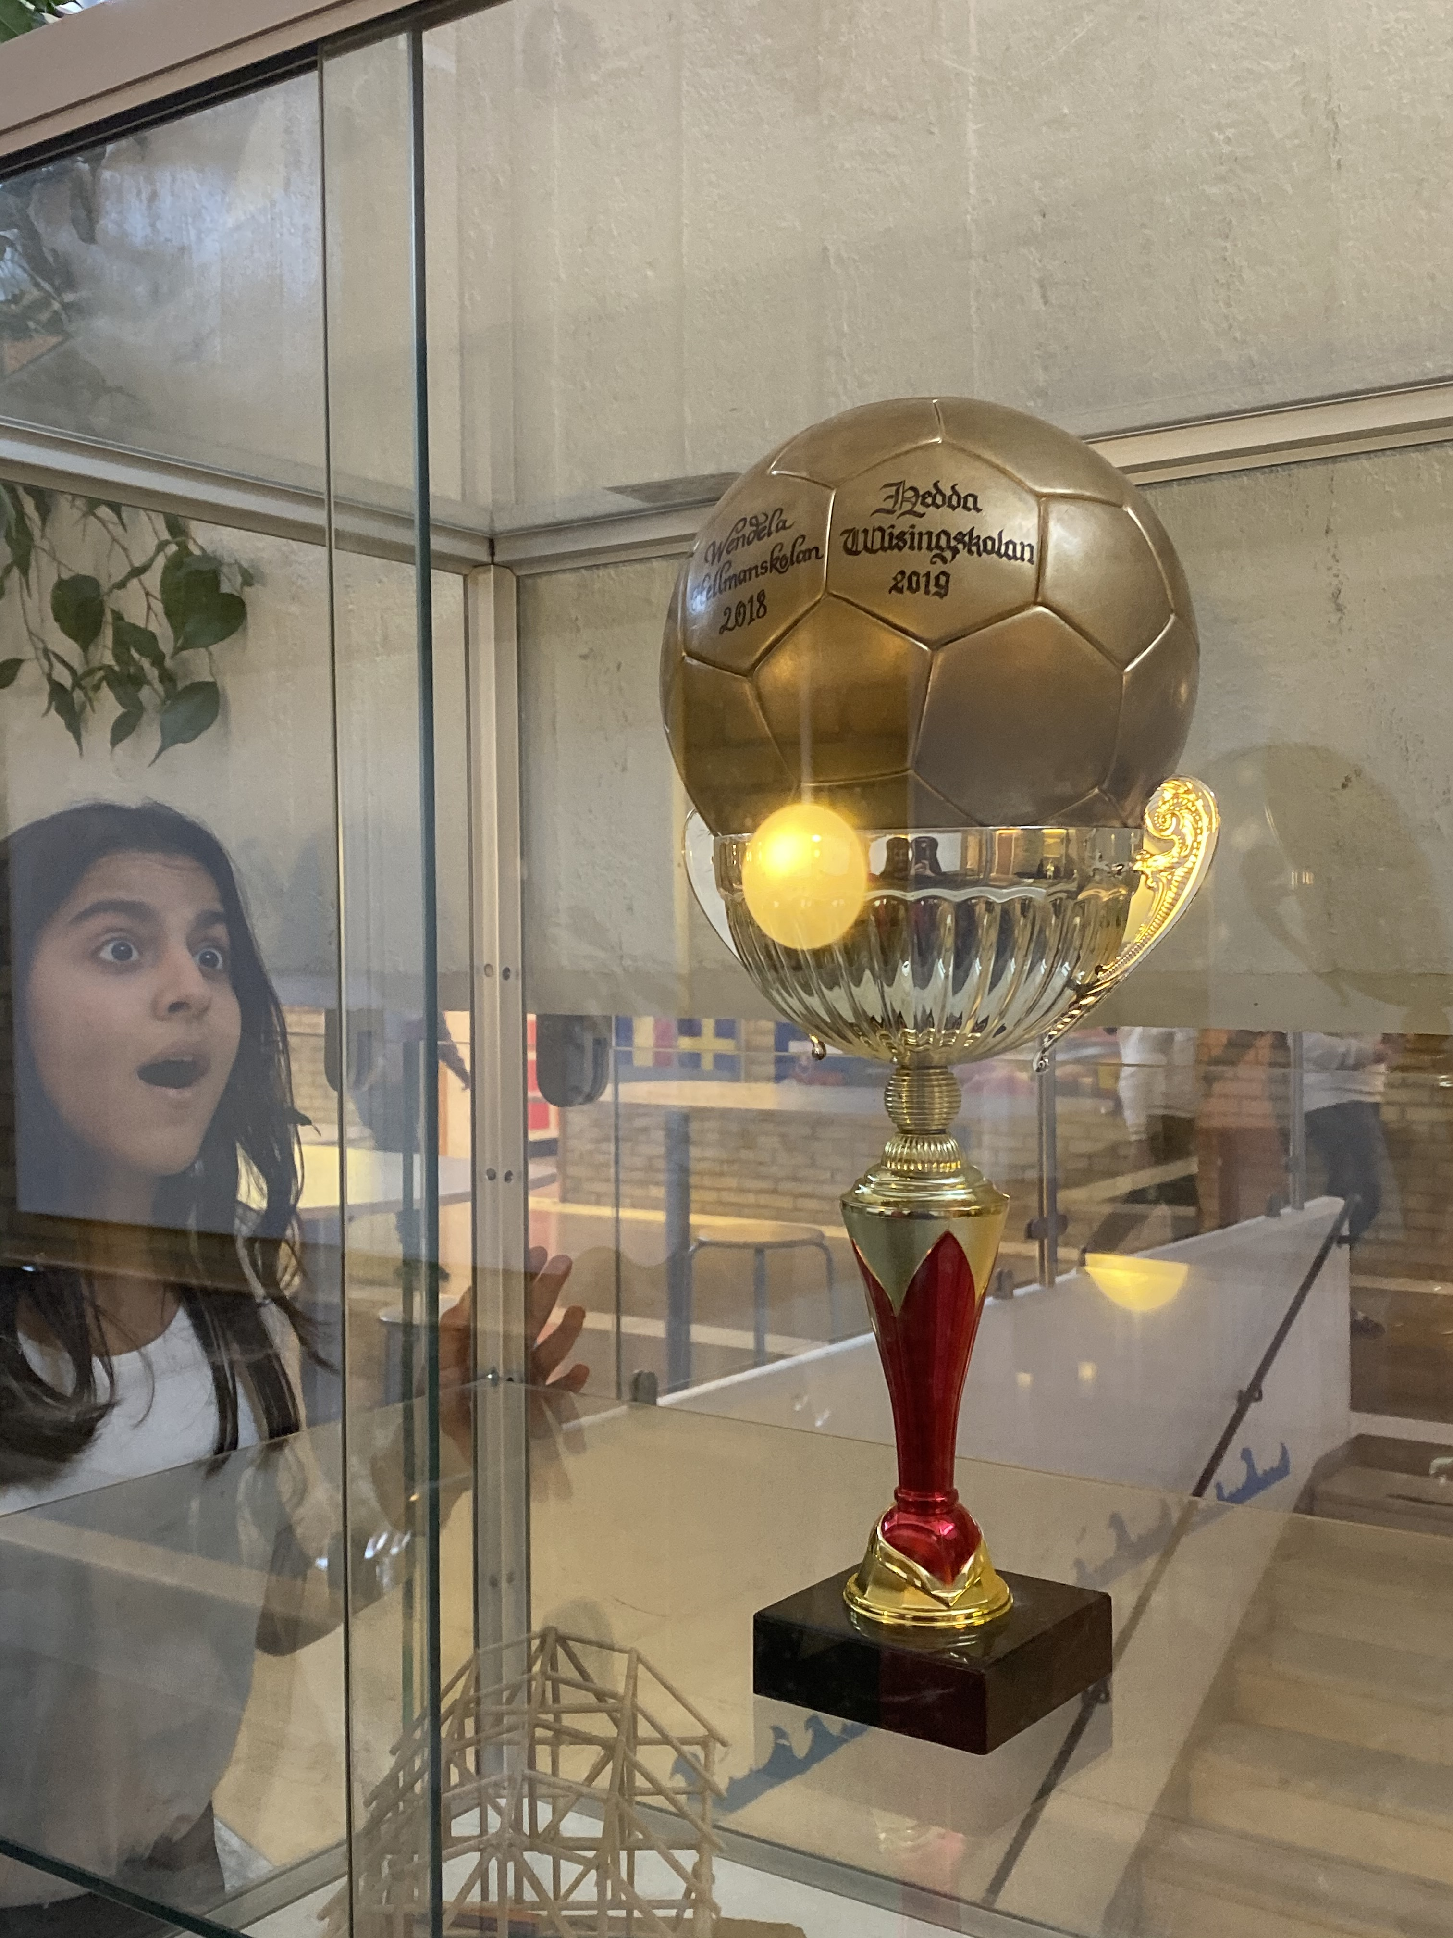
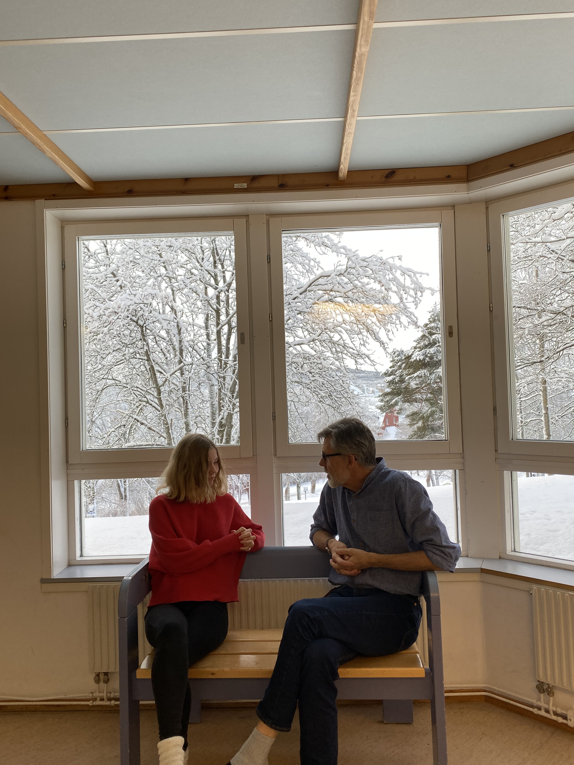
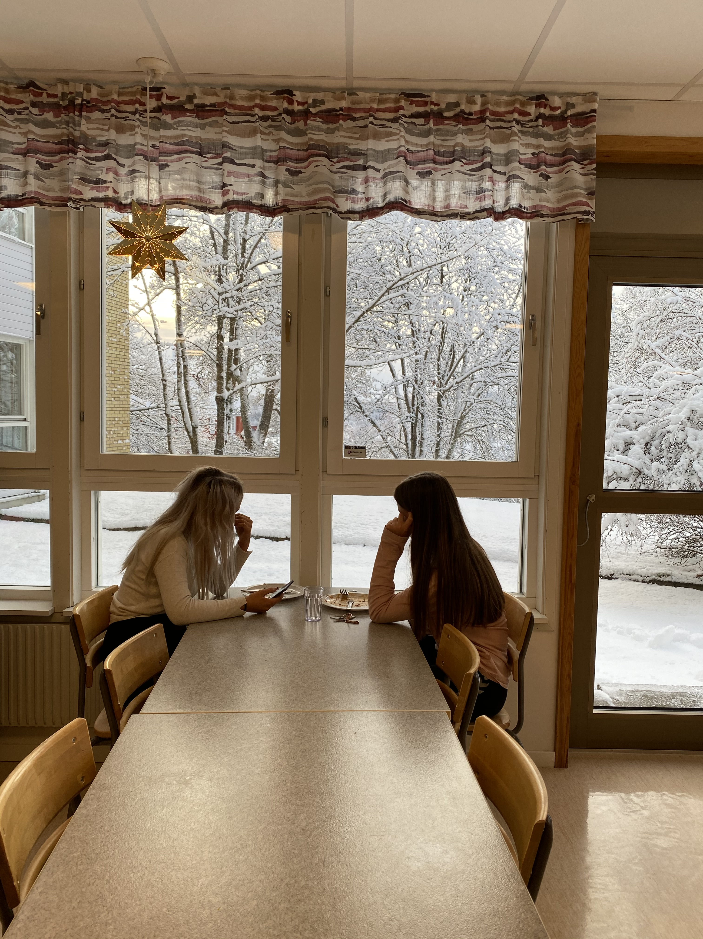
Facts about Hedda Wising
Our school recently won at a soccer game against another school in Härnösand. The students at Hedda Wising have great school spirit and many of them make an effort to wear the shool’s colors at tournaments and such.
Hedda Wising has a very active student council, which regularly interacts with the school’s teachers and always tries to make the school a better place!
Our school is very environmentally conscious. The cafeteria serves at least one vegetarian option for lunch every day and we are currently in the process of implementing recycling stations throughout the school.

Slide 28
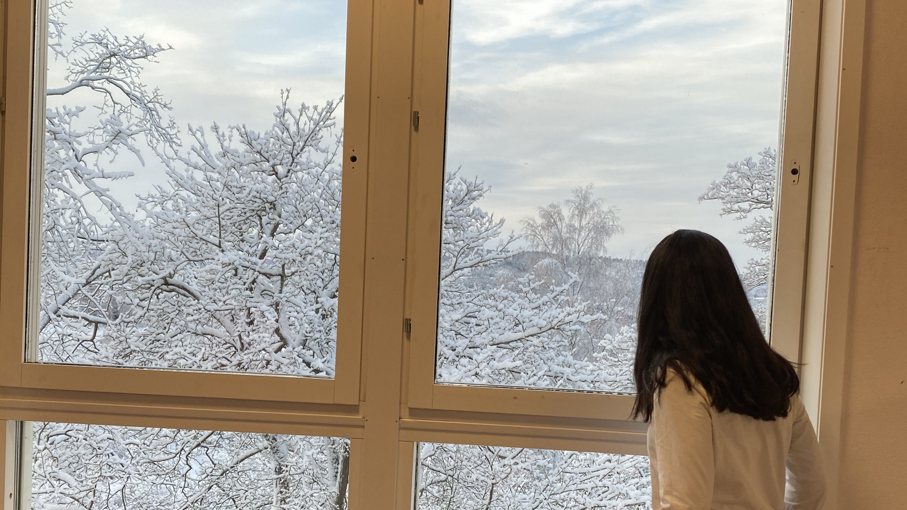
Thank you for your time!
We are very grateful for your little ”visit” to our school. We hope that it was an interesting, fun adventure for you!

